Slide 1
PPAP
Production Part Approval Process

Slide 2
Contents
Introduction
General
PPAP Document Requirement
Customer Notification and Submission Requirements
Submission to customer- Level of evidence
PPAP Process Requirement

Slide 3
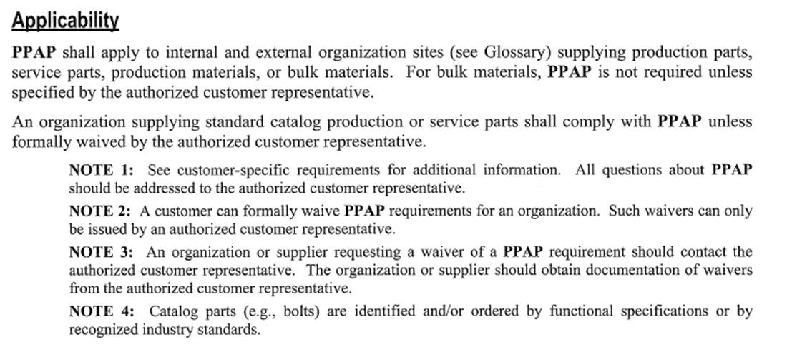
Introduction

Slide 4
General
Submission of PPAP
The organization shall obtain approval from the authorized customer representative for:
A new part or product
Correction of a discrepancy on a previously submitted part
Product modified by an engineering change to design records, specification or material

Slide 5
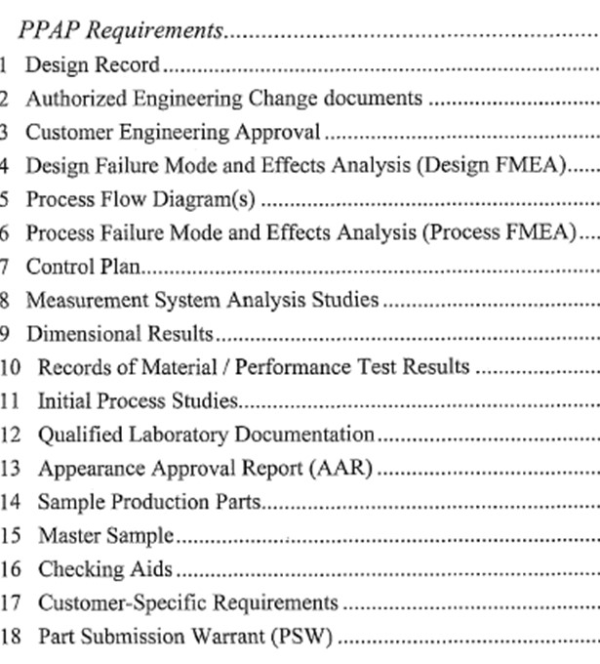
PPAP- Documents Requirement
The organization should meet all documents specified in AIAG PPAP manual along with customer specified requirements if any, list of docs are

Slide 6
PPAP- Documents Requirement
DESIGN RECORD:-
1 Drawings
2. CAD/CAM data
3. BLACK BOX Part - Record specifying interface and performance requirements
4. CATALOG PART– functional specification or a reference to a recognized industry standard
5. BULK MATERIAL- identification of raw material, formulations steps and parameters, and final product specification or acceptance criteria

Slide 7
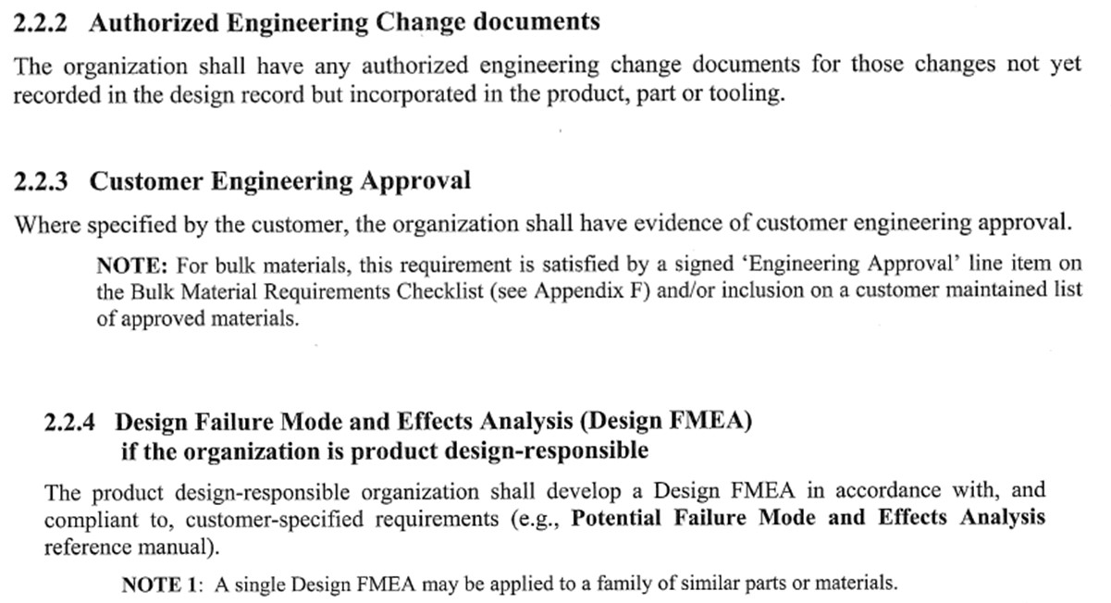
PPAP- Documents Requirement
2
3
4

Slide 8
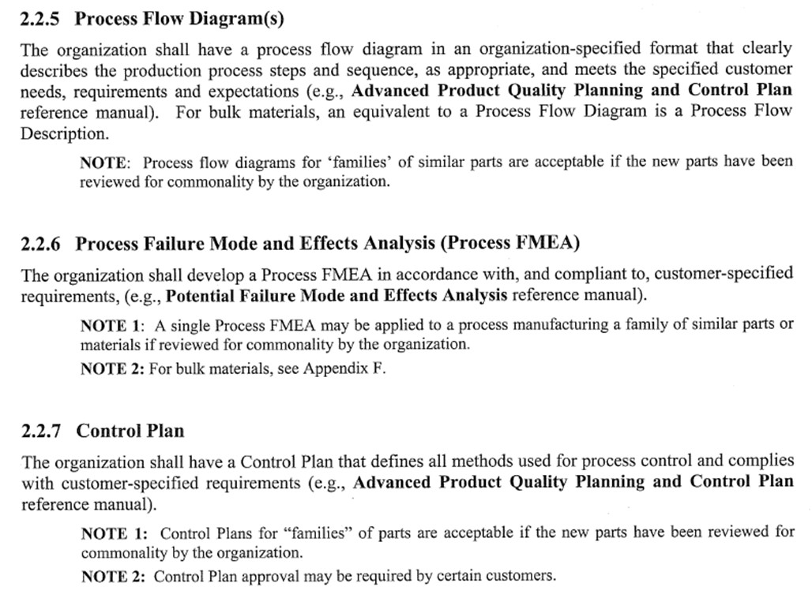
PPAP- Documents Requirement
5
6
7

Slide 9
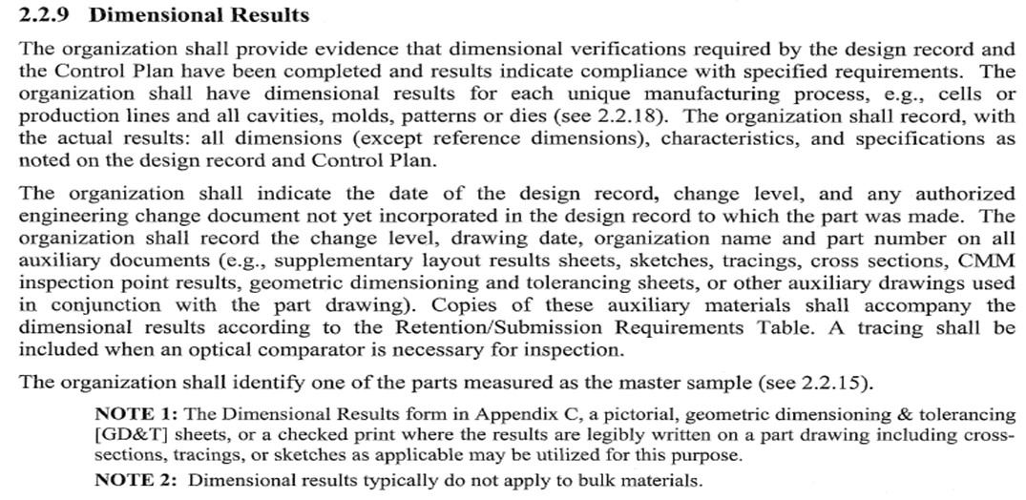
PPAP- Documents Requirement
8
9
7

Slide 10
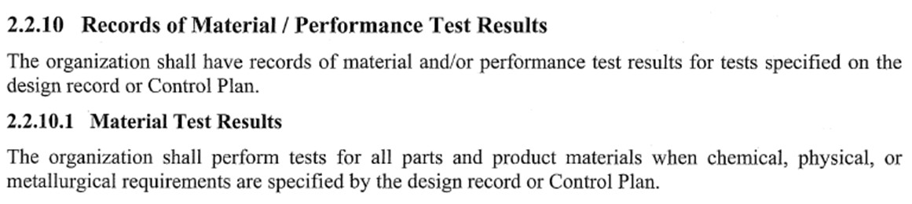
PPAP- Documents Requirement
10
10.1
10.2

Slide 11
PPAP- Documents Requirement
11. Initial Process Study
Initial process study is to be carried out for all Special characteristics, that is Fit, Function and Critical Characteristics
MSA must be performed for the instrument used to conduct initial process study
Initial Process studies are Short Term and will not predict effect of time and variation in 4M-T conditions over long run
A short term study should be carried out with 25 subgroups containing at least 100 readings from consecutive parts

Slide 12
PPAP- Documents Requirement
11.1 Quality Indices
Cpk- Capability index for stable process
Sigma – R-bar/d2- Within subgroup variation
Process capability based on variation observed within subgroup only
Indicator of how good a process can be if within subgroup variations are eliminated
Cpk should be calculated when process is stable
Ppk- Performance Index
Sigma- Root mean square- All of individual data
Process performance based on variation throughout full set of data
It is not limited to within subgroup variation
It can not isolate within subgroup variation from between subgroup variation
When process is unstable and under unknown causes Ppk to be used

Slide 13
PPAP- Documents Requirement
11.2 Acceptance Criteria
If above acceptance criteria is not satisfied,
Prepare improvement get customer agreement
Do 100% inspection as agreed with customer till improvement

Slide 14
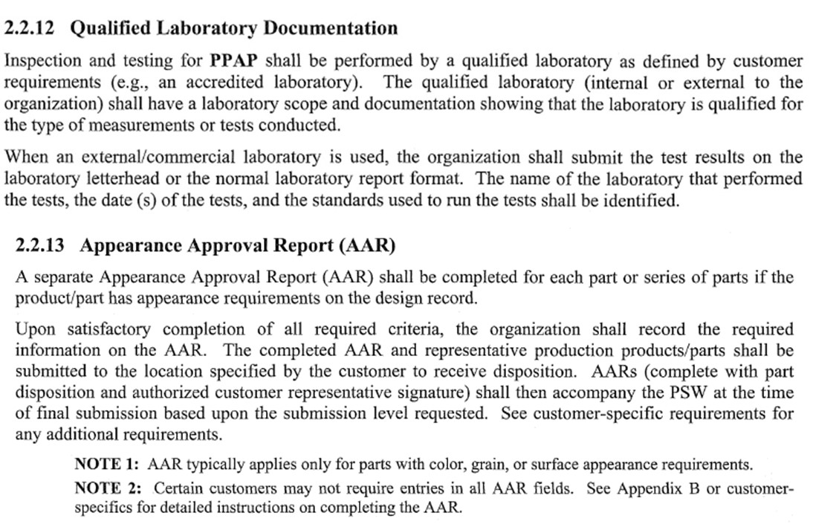
PPAP- Documents Requirement
12
13

Slide 15
PPAP- Documents Requirement
14
15
16

Slide 16
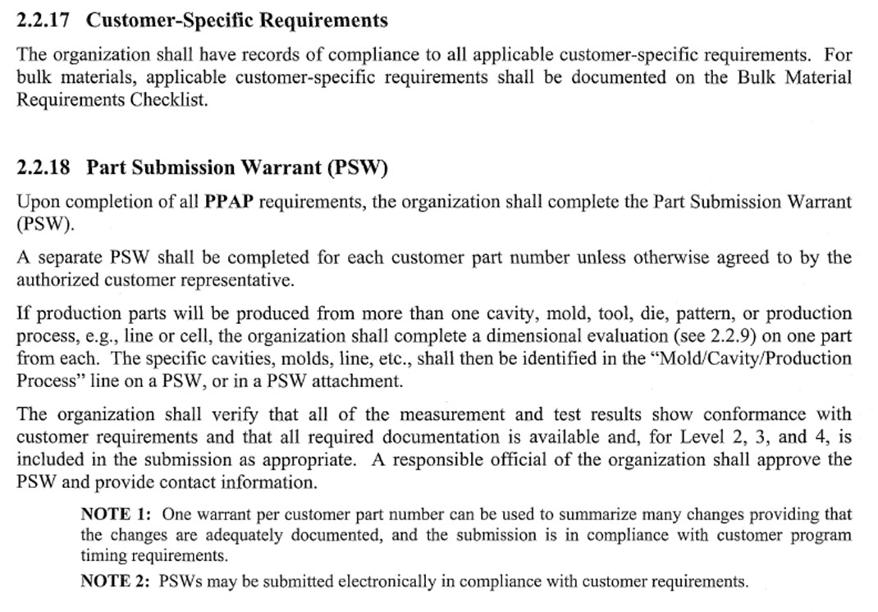
PPAP- Documents Requirement
17
18

Slide 17
PPAP- Documents Requirement
18.1

Slide 18
PPAP- Documents Requirement
18.1

Slide 19
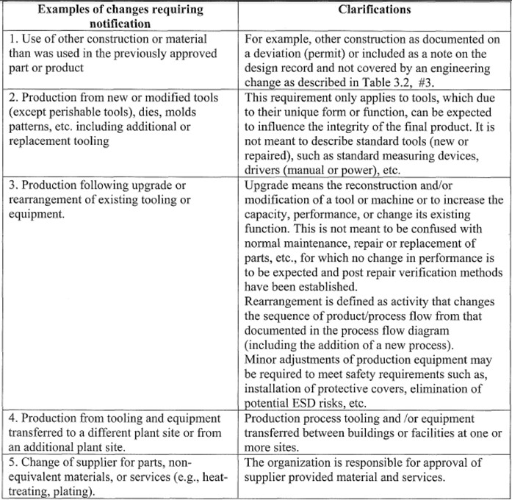
Customer Submission & Notification Requirements
Customer Notification
The organization shall notify customer of any planned changes as mentioned in table for approval in advance

Slide 20
Customer Submission & Notification Requirements
Customer Notification
The organization shall notify customer of any planned changes as mentioned in table for approval in advance

Slide 21
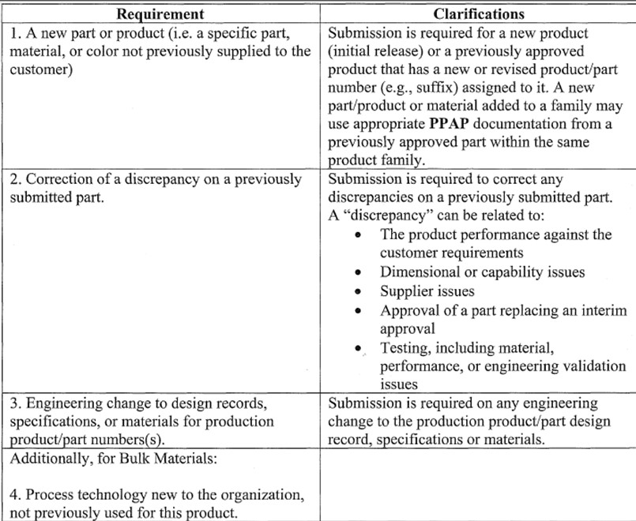
Customer Submission & Notification Requirements
Submission to Customer
The organization shall submit for PPAP approval prior to first production shipment in the following situations

Slide 22
Submission Level

Slide 23
Submission Level

