Slide 1
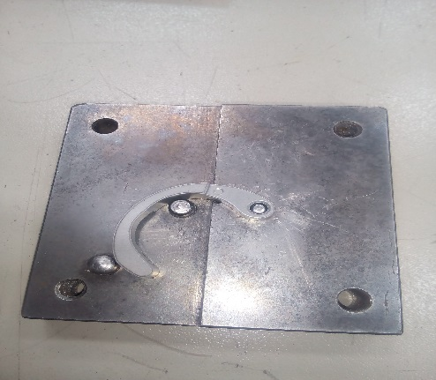
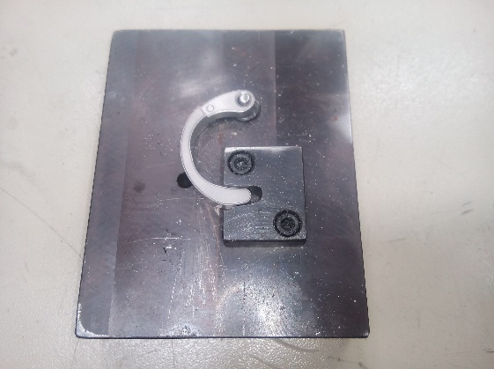
P15
TPM CIRCLE NO :- 01
ACTIVITY
KK
QM
PM
JH
SHE
OT
DM
E&T
KAIZEN IDEA SHEET
TPM CIRCLE NAME: Achiever
LOSS NO. / STEP
DEPT :- MACHINE SHOP
RESULT AREA
P
Q
A
B
C
D
S
M
CELL:- A105 FL WT
CELL NAME:- TENSIONER
MACHINE / STAGE :- DRILL MACHINE
OPERATION :- DRILLING
KAIZEN THEME:- To eliminate Accident on A105FLY WT DRILLING
IDEA :- New fixture to be provided with clamping
PROBLEM PRESENT STATUS :- While doing machining to fly wt operator need to hold job manually nearer to drill and spindle
COUNTERMEASURE:-
1. Slot provided for rest and clamp in new design
BENCHMARK
MINOR
TARGET
0
KAIZEN START
15.08.2016
TDC
26.08.2016
KAIZEN FINISH
26.08.2016
TEAM MEMBERS :-Santosh Wakchaure,
Walunj,vinod,amol,SUTAR
BENEFITS :-
NO UNSAFE CONDITION
Before
After
KAIZEN SUSTENANCE
WHY - WHY ANALYSIS :-
Why1 :- Operator need to hold job while drilling
Why2 :- no clamping provision
Why3 :- design weak
Why4 :- replace fixture
RESULT :-
NO ACCIDENT OR UNSAFE WORK CONDITION
WHAT TO DO:- Check point added in Sustenance audit check sheet.
HOW TO DO:- Check visually.
FREQUENCY :- Daily.
SCOPE & PLAN FOR HORIZONTAL DEPLOYMENT
Sr No | CELL | TDC | RESP. | STATUS
1
2
ROOT CAUSE : WEAK DESIGN OF FIXTURE
REGISTRATION NO. & DATE : 15.08.2016
REGISTERED BY :- santosh wakchaure
MANAGER’S SIGN :- d y pawar

