Slide 1
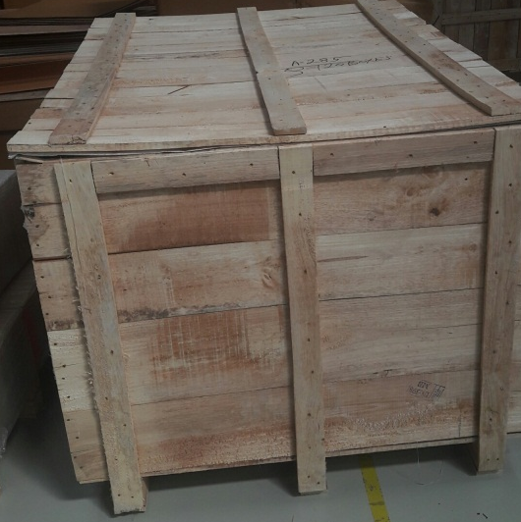
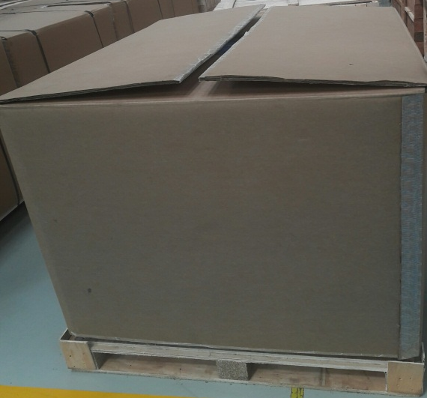
P15
TPM CIRCLE NO :-
ACTIVITY
KK
QM
PM
JH
SHE
OT
DM
E&T
KAIZEN IDEA SHEET
TPM CIRCLE NAME:
LOSS NO. / STEP
DEPT :- Dispatch
RESULT AREA
P
Q
A
C
D
S
M
CELL:-Export
CELL NAME:-Ducati Export Packing
MACHINE / STAGE :-
OPERATION :- Packing Material Change for A225/226
KAIZEN THEME : To Reduce Packing Cost of A225/A226 for Ducati Italy/Thailand
IDEA :- Packing Standard Change for A225/A226 Ducati
Problem present status :-
COUNTERMEASURE:-
BENCHMARK
0
TARGET
0
KAIZEN START
28.09.2016
TDC
30.10.2016
KAIZEN FINISH
01.11.2016
TEAM MEMBERS :
1.Anil Mane 3.Pandurang Kad
2.Sandeep Borkar4.Vinod Padvekar
5.Abhishek Grode 6.Priya Deshmukh
7.Nilesh Karpe 8.Amit Salunke/Ritesh
BENEFITS :-
Total Cost Saving Yearly Rs. 51813.00
Before
After
KAIZEN SUSTENANCE
WHY - WHY ANALYSIS :-
Existing Cost for 504 No’s – Rs.4080.00
Yearly Cost for 15988No’s - Rs.129426.67
RESULT :-
New Cost for 504 No’s – Rs.3114.41
Yearly Cost for 15988 No’s –Rs.98796.01
WHAT TO DO:- Box Type Change
HOW TO DO:-Wooden Box to Carton Box
FREQUENCY :- Weekly
ROOT CAUSE :-
Wooden Material not allowed at Italy / Thailand
REGISTRATION NO. & DATE :
SCOPE & PLAN FOR HORIZONTAL DEPLOYMENT
REGISTERED BY :-
SR.
NO.
CELL
TARGET
RESPONSIBILITY
STATUS
MANAGER’S SIGN :-
1
All Export
In process

