Slide 1
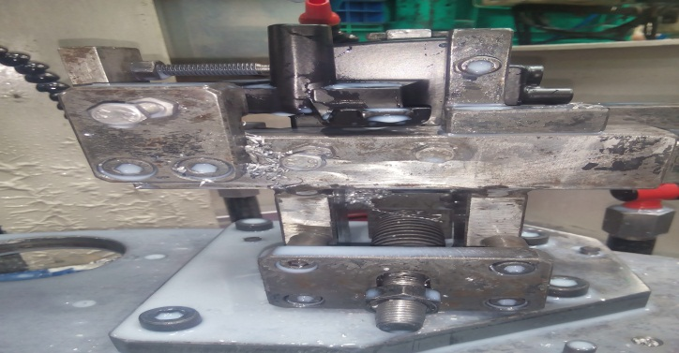
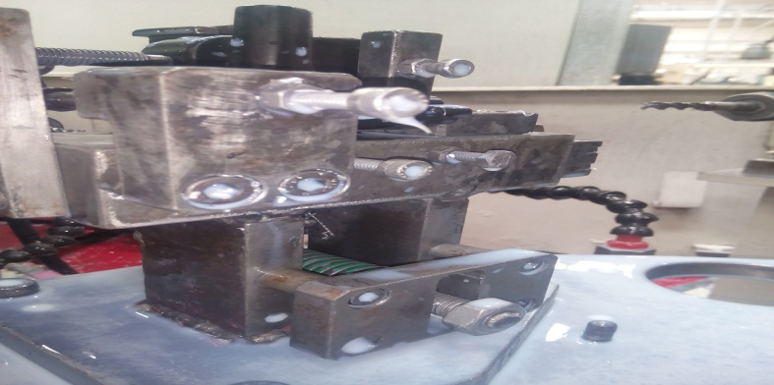
P15
TPM CIRCLE NO :- 01
ACTIVITY
KK
QM
PM
JH
SHE
OT
DM
E&T
KAIZEN IDEA SHEET
TPM CIRCLE NAME: Achiever
LOSS NO. / STEP
DEPT :- MACHINE SHOP
RESULT AREA
P
Q
A
C
D
S
M
CELL:- A247
CELL NAME:-Bracket & Lever
MACHINE / STAGE :- SPM
OPERATION :- Drilling Tapping.
KAIZEN THEME : A247 BKT SPM Clamping Force Less
IDEA :- Clamping Stud Guaide Block Area to be increase.
Problem Present Status :- A247 BKT SPM Component Lift in Auto Cycle.
COUNTERMEASURE:- bracket SPM clamping force less so clamping stud guide block area to be increase
BENCHMARK
95 no’s
TARGET
0 no
KAIZEN START
15.08.2016
TDC
20.08.2016
KAIZEN FINISH
TEAM MEMBERS : 1. Nitin Sutar,Navnath Karanjkhile,
Amol, Anil Rathod
BENEFITS :-
In-house rejection eliminated
Tool Cost Saving.
Production / Hr. Increased.
Clamping Stud life Increase.
Before
KAIZEN SUSTENANCE
After
WHY - WHY ANALYSIS :-
Why1 :- Compomanat lift in auto cycle
why2:- Clamping Pressure less
Why3 :- During Clamping Cond. Stud Foul in Guide Block
Why4 :- Clamping Stud Guide Block area less.
RESULT :-
In-house rejection eliminated
Tool Cost Saving.
Production / Hr. Increased.
WHAT TO DO:- Check point added in Sustenance audit check sheet . .
HOW TO DO:-. Check visually.
FREQUENCY :-
ROOT CAUSE :- Clamping Stud Guide Block area less.
REGISTRATION NO. & DATE : 20.08.2016
SCOPE & PLAN FOR HORIZONTAL DEPLOYMENT
REGISTERED BY :-Sagar Namekar.
SR.
NO.
CELL
TARGET
RESPONSIBILITY
STATUS
MANAGER’S SIGN :- Ganesh Gaikwad
1
Not Applicable

