Slide 1

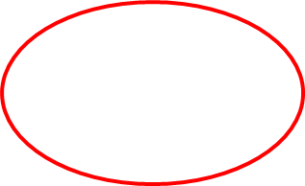
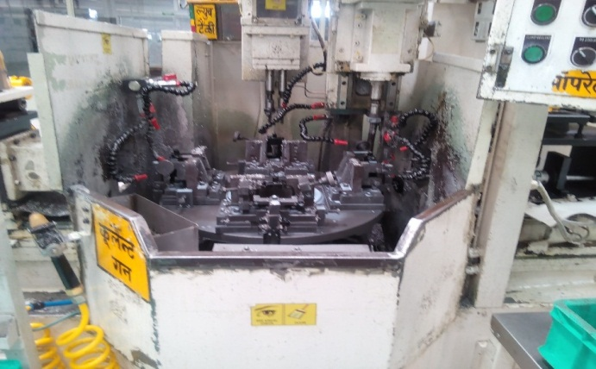
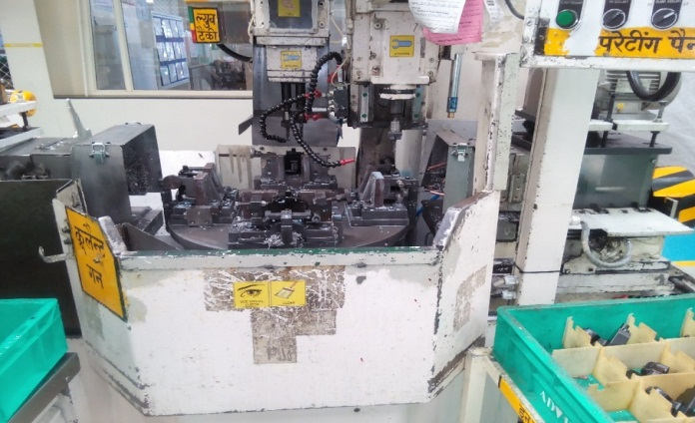
AHPL/QMS/FR/09/E
TPM CIRCLE NO :-
ACTIVITY
KK
QM
PM
JH
SHE
OT
DM
E&T
KAIZEN IDEA SHEET
TPM CIRCLE NAME:
LOSS NO. / STEP
DEPT :- Maint
RESULT AREA
P
Q
A
C
D
S
M
CELL:- M/C Shop
CELL NAME:- CBS Cell
MACHINE / STAGE :- BKT SPM A1
OPERATION :- Drilling & Tapping
KAIZEN THEME :To Reduce JH time At Bracket SPM A1
IDEA : Separate Unit Wise Guard Provided .
Problem present status :- Required More time For JH Activity (Cleaning)
COUNTERMEASURE:- Local make side guard fit
BENCHMARK
TARGET
0
KAIZEN START
25.03.2017
TDC
1.4.2017
KAIZEN FINISH
5.4.2017
TEAM MEMBERS : Prakash,Sujit,Vasant
BENEFITS :-
Operator JH time reduce 5 min/Shift
Before
After
KAIZEN SUSTENANCE
WHY - WHY ANALYSIS :-
1) Single Guard Provided To All Unit
2) Fixture cleaning Difficult
3)Required More Time For JH Activity
4) Hard To Access
RESULT :-
WHAT TO DO:- Check guard location
HOW TO DO:- In JH
FREQUENCY :- Daily
JH TIME
ROOT CAUSE :- Hard To Access .
REGISTRATION NO. & DATE: 10.4.2017
SCOPE & PLAN FOR HORIZONTAL DEPLOYMENT
REGISTERED BY :-Prakash
SR.
NO.
CELL
TARGET
RESPONSIBILITY
STATUS
MANAGER’S SIGN :- SNC
1
CBS B1,A2,B2
20.5.2017
Prakash & Sujit
Pending
Rev. No.:01, Rev. Date:15.12.2016

