Slide 1

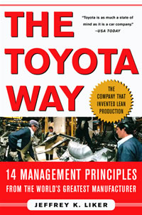
Lessons Learned from
the Toyota Way

Slide 2
“4 P” Model of the Toyota Way
Continual organizational learning through Kaizen
Go see for yourself to thoroughly understand the situation. (Genchi Genbutsu)
Make decisions slowly by consensus, thoroughly considering all options; implement rapidly (Nemawashi)
Problem
Solving
(Continuous
Improvement and Learning)
Grow leaders who live the philosophy
Respect, develop and challenge your people and teams
Respect, challenge, and help your suppliers
People and Partners
(Respect, Challenge and Grow Them)
Create process “flow” to surface problems
Level out the workload (Heijunka)
Stop when there is a quality problem (Jidoka)
Use pull systems to avoid overproduction
Standardize tasks for continuous improvement
Use visual control so no problems are hidden
Use only reliable, thoroughly tested technology
Process
(Eliminate Waste)
Philosophy
(Long-term Thinking)
Base management decisions on a long-term philosophy, even at the expense of short-term financial goals

Slide 3
Lean Manufacturing
is a manufacturing philosophy which shortens the time between the customer order and the product build / shipment by eliminating sources of waste.
Business as Usual
CUSTOMER
ORDER
Waste
PRODUCT
BUILT & SHIPPED
Time
Lean Manufacturing
CUSTOMER
ORDER
PRODUCT
BUILT & SHIPPED
Waste
Time (Shorter)

Slide 4
DIFFERENCE BETWEEN TRADITIONAL AND LEAN MANUFACTURING
 | TRADITIONAL MASS PRODUCTION | LEAN PRODUCTON
Production schedules are based on… | Forecast — product is pushed through the facility | Customer Order — product is pulled through the facility
Products manufactured to… | Replenish finished goods inventory | Fill customer orders (immediate shipments)
Production cycle times are… | Weeks/months | Hours/days
Manufacturing lot size quantities are… | Large, with large batches moving between operations; product is sent ahead of each operation | Small, and based on one-piece flow between operations
Plant and equipment layout is… | By department function | By product flow, using cells or lines for product families
Quality is assured… | Through lot sampling | 100% at the production source
Workers are typically assigned… | One person per machine | With one person handling several machines
Worker empowerment is… | Low — little input into how operation is performed | High — has responsibility for identifying and implementing improvements
Inventory levels are… | High — large warehouse of finished goods, and central storeroom for in-process staging | Low — small amounts between operations, ship often
Inventory turns are… | Low — 6-9 turns pr year or less | High — 20+ turns per year
Flexibility in changing manufacturing schedules is… | Low — difficult to handle and adjust to | High — easy to adjust to and implement
Manufacturing costs are… | Rising and difficult to control | Stable/decreasing and under control

Slide 5
Product Lead Time
Value Added Time is only a very small percentage of the Lead time.
Traditional Cost Savings focused on only Value Added Items.
LEAN FOCUSES ON ELIMINATING NON-VALUE ADDING ACTIVITIES.

Slide 6
Types of waste
Overproduction: Producing items for which there are no orders, which generates such wastes as overstaffing and storage and transportation costs because of excess inventory.
Waiting: Workers having to stand around waiting for the next processing step, tool, part etc. Or no work because of stock-outs, lot processing delays, equipment downtime, and capacity bottlenecks.
Unnecessary transport: Carrying WIP long distances, creating inefficient transport, or moving parts in and out of storage facility.
Over-processing or incorrect processing: Taking unneeded steps to process the parts. Inefficient processing due to poor tools and product design, causing unnecessary motion and producing defects. Waste generated when providing higher-quality products than is necessary.
Excess inventory: Excess raw material, WIP or finished goods causing longer lead times, obsolescence, damaged goods. Extra inventory hides problems such as production imbalances, late deliveries from suppliers, defects, equipment downtime, and long set-ups.
Unnecessary movements: Any wasted motion employees have to perform during the course of their work, such as looking for, reaching for, or stacking parts, tools etc. Walking is a waste.
Defects: Production of defective parts or correction. Repair or rework, scrap, replacement production, and inspection mean wasteful handling, time and efforts.
Unused employee creativity: Losing ideas, skills, improvements, and learning opportunities by not engaging or listening to your employees.

Slide 7

Flow means “When your
customer places an order, a
process of obtaining raw
materials is triggered, the raw
materials then flow in to a
manufacturing area where
Team Members manufacture
the product, complete the
order and order flows
immediately back to the
customer”.
Creating Flow helps to expose inefficiencies that demand immediate solutions

Slide 8
Before Lean: Organization By Machine Type With Convoluted Flow
No Organization and No Control

Slide 9
After Lean: U-Shaped One-Piece Flow Cell
Organization and Control
Build to
Takt Time!

Slide 10
ADVANTAGES OF CELLULAR MANUFACTURING
1. On-Time delivery
2. Improved response
3. Reduced inventory
4. Improved quality
5. Improved workflow
6. Achievement of flexibility
7. Culture change
8. Delegation of accountability
9. Better use of plant
10. Better use of skilled labor
11. Job satisfaction
12. Information Flow

Slide 11
TAKT TIME – THE HEART BEAT OF SINGLE PIECE FLOW
Takt is a German word for rhythm or meter. Takt is the rate of
customer demand – the rate at which customer is buying the
product.
T = Ta / Td
Where
T = Takt time, e.g. [minutes of work / unit produced]
Ta = Net Time available to work, e.g. [minutes of work / day]
Td = Time demand (customer demand), e.g. [units required / day]

Slide 12
TAKT TIME – IMPLEMENTATION ADVANTAGES
Once a takt system is implemented there are a number of benefits:
The product moves along a line, so bottlenecks are easily identified when the product does not move on in time.
Correspondingly, stations that don't operate reliably (suffer frequent breakdown, etc.) are easily identified.
The takt leaves only a certain amount of time to perform the actual value added work. Therefore there is a strong motivation to get rid of all non value-adding tasks (like machine set-up, gathering of tools, transporting products, etc.)
Workers and machines perform sets of similar tasks, so they don't have to adapt to new processes every day, increasing their productivity.
As all products are "stuck" in the line and cannot leave it; they cannot be "lost" somewhere on the shop floor.
Takt can be used to set the pace of production and alert Team Members whenever they are getting ahead or behind.

Slide 13
Benefits of One-Piece Flow
Builds in quality – Every Team Member is an inspector and works to fix problems in station before passing them on. If defects do get passed on, they are detected quickly and problem can be immediately diagnosed and corrected.
Creates flexibility – If shorter lead times, more flexibility to respond and make what customer really wants. Pushes for set-up time reduction.
Creates higher productivity – Every easy to spot the busy or idle station and easier to calculate the value-added work.
Frees up floor space – Because of inventory storage reduction.
Improves safety – Smaller batches means simpler transportation system and less accidents because of forklifts.
Improves morale – People do high percentage value-added work and can see the results of their work faster.
Reduces cost of inventory – Free up capital to invest elsewhere; inventory obsolescence goes down.

Slide 14
Mistakes to avoid while implementing Single Piece Flow
Setting up a Fake Flow – Wherein the impression is equipment placed close together to create what seems like a one piece flow cell, but the product batches out at each stage with no sense of customer Takt Time. It looks like a cell, but works like a batch process.
Back tracking after implementing Single Piece flow – This can happen when people realize that there may be a cost associated with creating flow. This cost can be:
a) There is a breakdown in one piece of equipment causing the
whole cell to stop production.
b) A changeover of another piece of equipment takes longer than
expected and delays the whole cell, stopping production.
c) Outsourced batch processing are to be brought inhouse for the
sake of single piece flow

Slide 15
Roadmap to Implement Single Piece Flow
Strategies | Primary Lean Tools | Secondary Lean Tools
Continued Elimination of waste | Cell Design | Kanban
Force problems to surface | Pull Techniques | Supermarkets
Make problems uncomfortable to live with | Clearly internal and external customer – supplier relationships | FIFO lanes
Establish connected processes to create interdependency | Visual Controls | Problem Solving tools
Identify weak links in the flow and strengthen them | TPM, SMED (Quick Changeover) | Standardized work

Slide 16
Sequential Steps to implement Single Piece Flow
Using the Current state map as a guide, walk the path of the material flow once again.
Identify wasteful and inflexible processes in your map.
Identify root causes of wastes and eliminate them.
List the causes of inflexibility for these processes such as long set-up times or shared resources, etc.
Evaluate each supplier-customer relationship in the process map.
Determine whether each relationship will use a FIFO style connection or a supermarket style connection.
Develop a plan to define each connection in terms of what will be included, unit of measurement, quantity and where the material will be.
Determine whether space needs to be dedicated, whether container or trollies are to be dedicated and whether resources are dedicated to this connection.
Identify the Control mechanism for each connection and how we plan to make it visual and easy to verify adherence.
Measure the Cycle times of each operation in the Process flow and create a cycle balance chart to determine current Operation balance.

Slide 17
Identify the physical signs of work imbalance (such as waiting, inventory accumulation, transportation, rework, etc.) and highlight these on the current state map.
Work towards eliminating the work imbalance and re-design the Operation cycle time balance chart.
Run operations based on Takt time which balances with Process Cycle
times.
Evaluate implementation of Single piece flow by walking through the process all over again after a specified period of time.

Slide 18
What is a Visual Workplace?
When anyone can walk into a workplace and visually understand the current situation.
4

Slide 19
Describe this area...

Slide 20
Describe this area...

Slide 21
What is TPM?
Total Productive Maintenance (TPM)
is
Productive Maintenance with
EVERYONE’s participation
Maintenance=Teachers, Doctors of Equipment
Operators=Clean, inspect, routine repair

Slide 22
Why Quick Change Over?
Change Over
Difference in average inventory level with more changeovers
Average inventory levels
Inventory level
Time
The more quickly we changeover, the more our inventory levels decrease. This helps accomplish our goal of waste elimination.

Slide 23
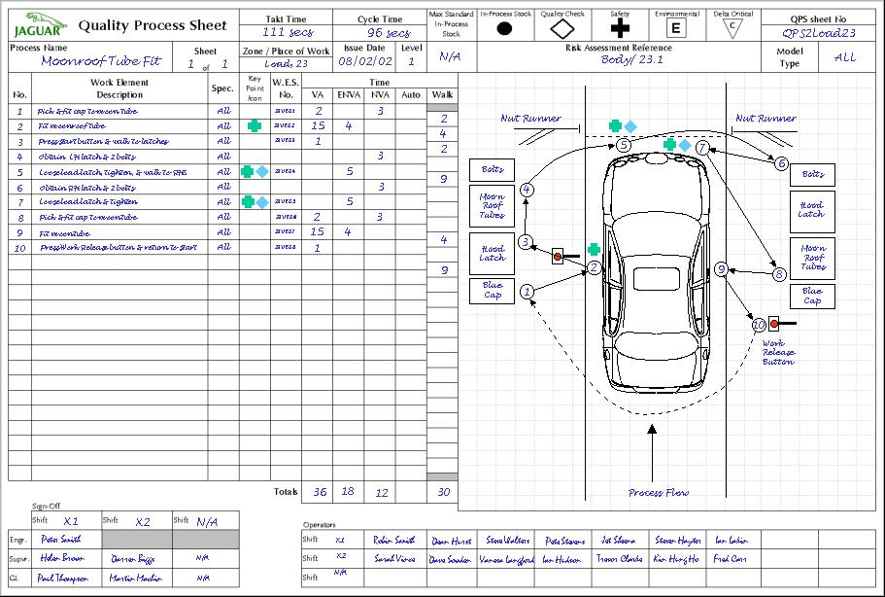
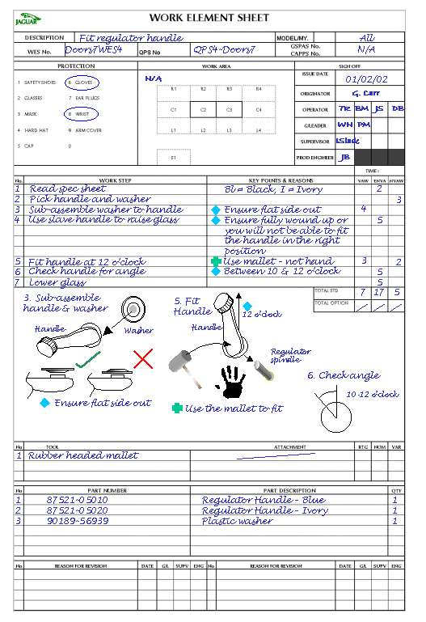
Standard Work Tools
Standardized
Work Chart
Detail of each
Process Step
Takt
90s
1
2
3
4
5
Assembly Process #
Work Element Sheet
Stack Chart
(Yamazumi)
Detail of the Elements
of each Process Step
A Visual Tool for Balancing Processes

Slide 24
One-Piece Flow Demands Team Work!
x
x
x
x
x
Traditional Western Team
x
x
x
x
x
x
x
x
x
x
x
x
Need
help?
Need
help?
Toyota Way Team
X
Workcell

Slide 25
Key Criteria for achieving Single Piece Flow
Ensure consistent capability - The Operation must be capable of fulfilling customer requirements.
Consistent application and availability of resources – people, materials and equipment
Reliability of processes and equipment – Upkeep of machines and equipment is of prime importance (TPM)
Operation cycle times must be balanced to the takt time – uneven work times will create waiting time and over-production.

Slide 26
Single Piece Flow - Learnings
When Operations are linked together, there is more
teamwork, rapid feed-back on earlier quality problems,
control over the process and direct pressure for people
to solve problems and think and grow. Ultimately Single
Piece Flow challenges people to think and improve,
Because of this focus on thinking, the Toyota
Production System is now also being referred as the
Thinking Production System

Slide 27
Principle 2: Create continuous process flow to bring problems to the surface
Redesign processes to achieve continuous flow.
Create flow to move material and information fast.
Link processes and people so that problems surface right away.
Make flow obvious throughout your organizational culture.

Slide 28
Principle 4: Level out workload (heijunka)
Eliminating Muda is just one third of the equation for making lean successful. Eliminating Muri and eliminating Mura in production are just as important.
Muda (waste)
  Transportation, Inventory, Movement, Waiting, Overproduction, Over processing, Defects + Unused employee abilities
Muri (overburdening people or equipment) – Overburdening People results in Safety, Quality and Morale problems; Overburdening Equipment causes breakdowns and defects
Mura (unevenness) →Heijunka (evenness) – Unevenness in production levels means it will be necessary to have on hand the equipment, materials and people for the highest level of production – even if the average requirements are much lower than that.

Slide 29
Principle 4: Level out workload (heijunka)
Achieving Leveled work schedule or Heijunka helps in
eliminating Mura which is fundamental to eliminating Muri
(Overburden) and Muda (Waste)
Heijunka is leveling of both volume and product mix. It does
not build products according to the actual flow of customer
orders which can swing up and down wildly, but takes the
total volume of orders in a period and levels them out so
that the same amount and mix are being made each day.

Slide 30
Principle 4: Level out workload (heijunka)
Effects of Unleveled Workload or Production Schedules
Customers do not usually buy products predictably - This leads to a high level of unused inventory at the producer’s end.
There is a Risk of unsold Goods
The use of Resources is unbalanced
Places an uneven demand on upstream processes like Supply Chain Management
Benefits of leveled Workload (Heijunka) or Production Schedules
Flexibility to make what the customer wants and when they want it – This reduces plant inventory carrying costs.
Reduced Risk of unsold Goods
Balanced use of labour and machines
Smoothed demand on upstream process thereby easing out the value chain

Slide 31
Sequential Steps to implement Leveled Schedules
Determine the extent of fluctuation of daily/ weekly demand of customer.
Identify current methods of aligning resources to these fluctuations and our effectiveness in meeting requirements (Delivery Compliance, Customer PPM and Overhead costs).
Evaluate the effect of variation in demands and decide whether leveling the product flow would be beneficial.
Analyze current problems / issues which prevent us from making smaller quantities more frequently and consistently.
Determine average daily volume demand for different products.
Create a pattern of product mix and volume to be produced daily.
The leveled schedule is the standard for Operation. Measure our effectiveness in achieving the standard and correct obstacles that prevent consistent ability to achieve the schedule.
All material supplied from stores also follow the same sequence of leveled distribution.
The leveled schedule becomes the basis for calculating takt times and establishing standard work.

Slide 32

Detect normal from abnormal
– right now!

Slide 33
Words of Wisdom
“It is not the strongest nor the most intelligent of the species that survives, but the one that is most adaptable to change”
-Charles Darwin-

Slide 34
Final Thoughts
“Every day, little up”
“Some days, big up”
Please try
Do your best
“Until you take the first step, it will not be possible to see the next step”

Slide 35
Happy Learning!!!!!!

