Slide 1
The Toyota Way
Principle 11 – Respect you extended network of Partners and Suppliers by challenging them improve.

Slide 2
The Toyota Approach : 4Ps
Continuously solving root PROBLEMS
Principles 12-14
Add value to the organization by developing your PEOPLE and PARTNERS
Principles 9-11
The right PROCESS will produce the right results
Principles 2-8
Long Term PHILOSOPHY
Principle 1

Slide 3
14 Management Principles
Base your management decisions on a long term philosophy, even at the expense of short term financial goals.
Create continuous process flow to bring problems to the surface.
Use “pull” systems to avoid overproduction.
Level out workload (heijunka).
Build a culture of stopping to fix problems, to get quality right the first time.
Standardized tasks are the foundation for continuous improvement and employee empowerment
Use visual controls so no problems are hidden.
Use only reliable thoroughly tested technology that serves your people and processes.
Grow leaders who thoroughly understand the work, live the philosophy, and teach it to others
Develop exceptional people and teams who follow your company’s philosophy
Respect you extended network of partners and suppliers by challenging them improve.
Go and see for yourself to thoroughly understand the situation
Make decisions slowly by consensus, thoroughly considering all options; implement decisions rapidly
Become a learning organization through relentless reflection (hansei) and continuous improvement (kaizen)

Slide 4
Partnership -- Definition
A partnership is a tailored business relationship based on mutual trust, openness, shared risk and shared rewards that results in business performance greater than would be achieved by two firms working together in the absence of partnership.

Slide 5
Principle 3: Respect your extended network of suppliers
Find solid partners & grow together for a long term benefit of both.
  Suppliers must prove themselves over time.
  Once done, they are “Part of the Family”.
Treat partners as an extension of your team.
Set challenging targets & assist in achieving them.
Clean your own house first.
Learn to take advantage of their technological advancements.
Outsourcing while retaining mastery of the technology.

Slide 6
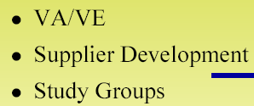
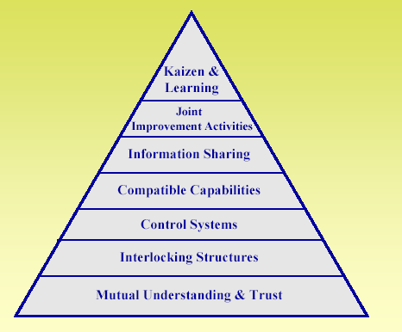

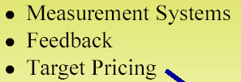
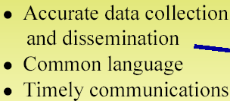


Supply Chain needs hierarchy

Slide 7
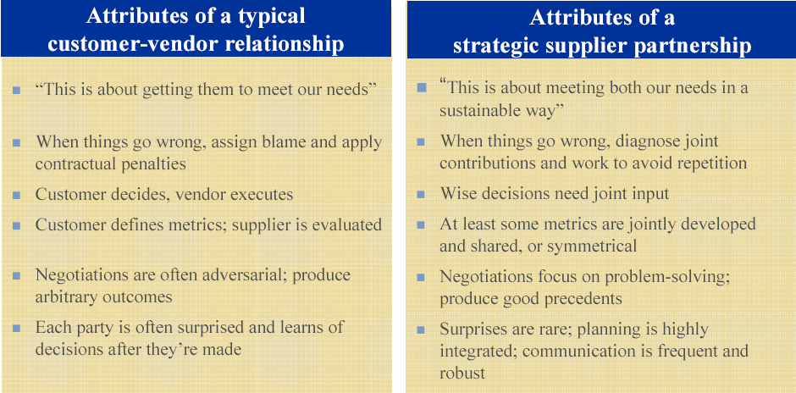
Supplier Relationship management

Slide 8
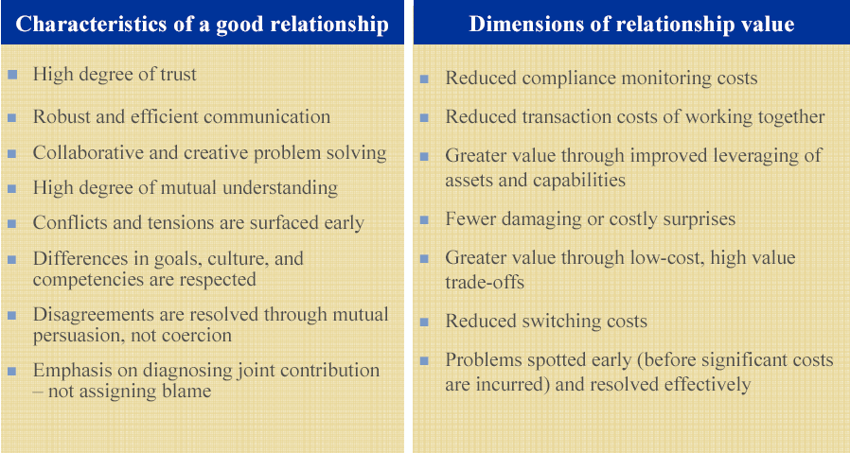
Good Relationship
Characteristics = Value
8

Slide 9
Benefits of Supplier Relationship
Achievement of desired results
(e.g.product and / or best service, delivered cost effectively)
Ultimately – Customer Satisfaction

