Slide 1
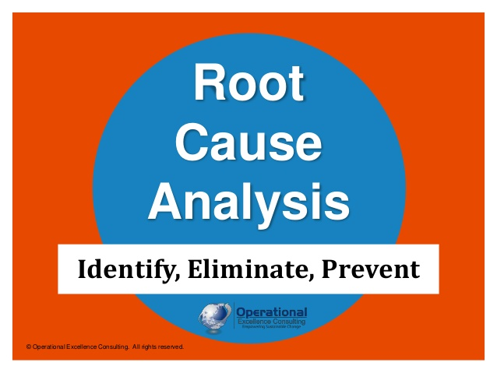

Theme: Get To The Root Cause

Slide 2
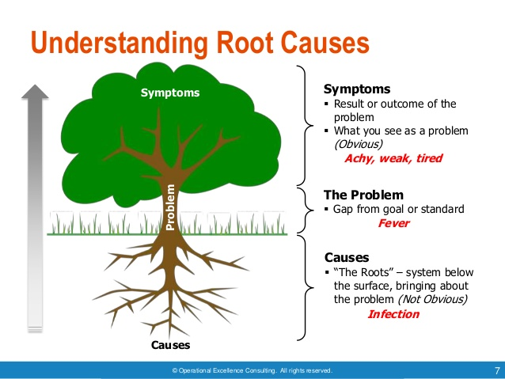
Example
Shaft Fitment Problem
Body ID Undersize by 20 micron
Tool life/ correction not followed

Slide 3
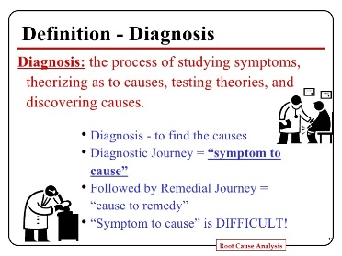
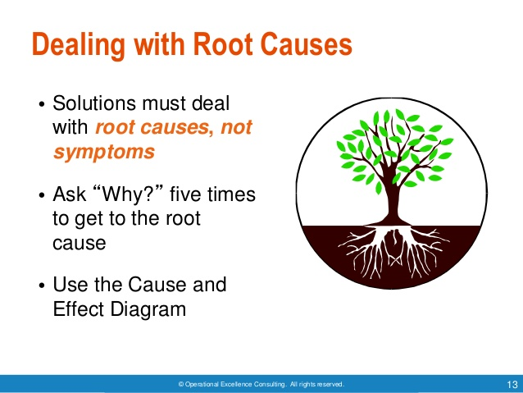
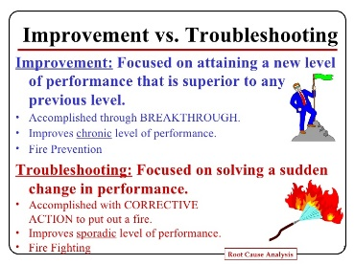
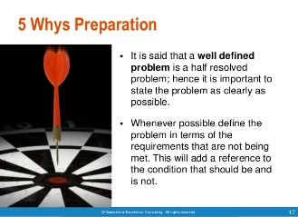

Slide 4
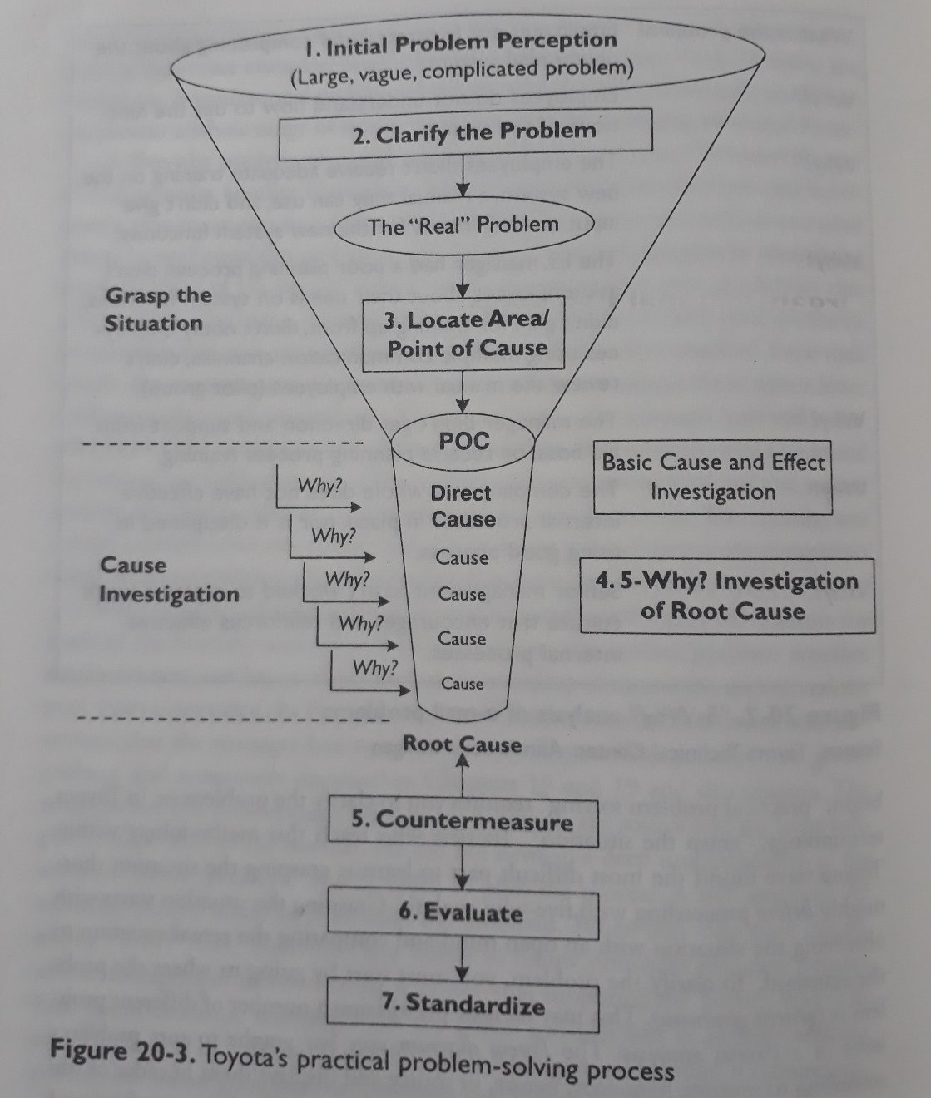
Problem Solving Process
Problem Statement
Cause Validation
Root Cause Identification
Countermeasures

Slide 5
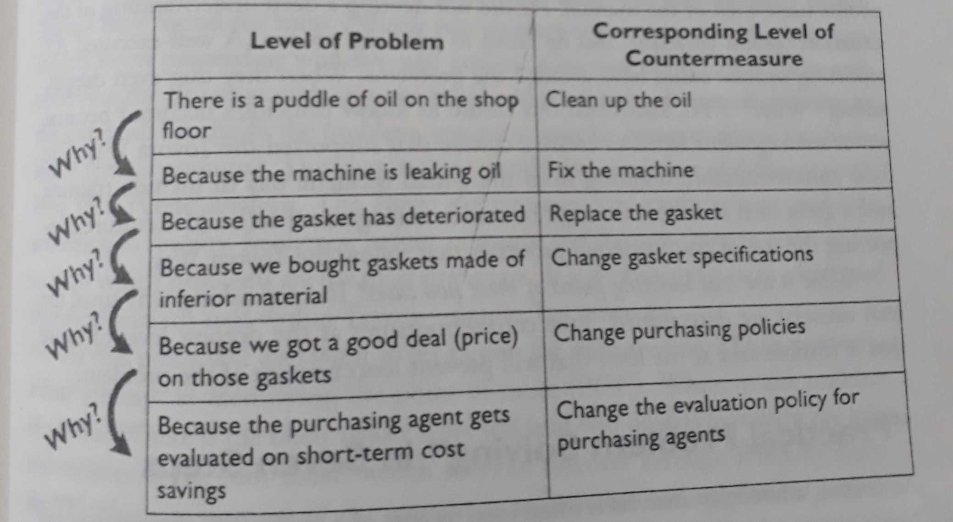
Example- 5 Why

Slide 6
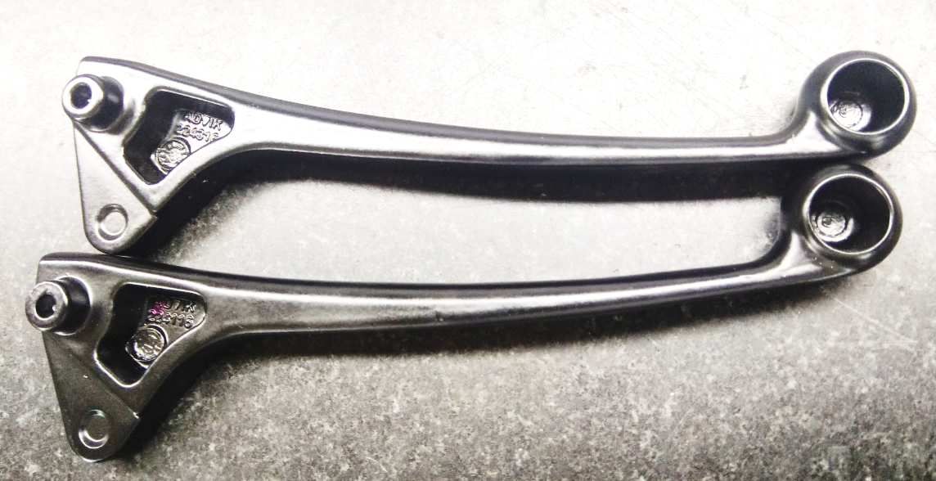
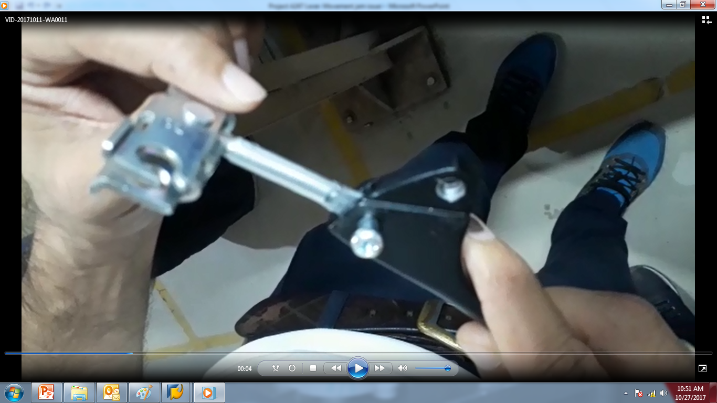
Case Study
“To eliminate the defect of A247 Lever movement Jam “

Slide 7
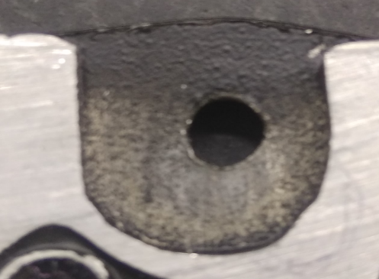
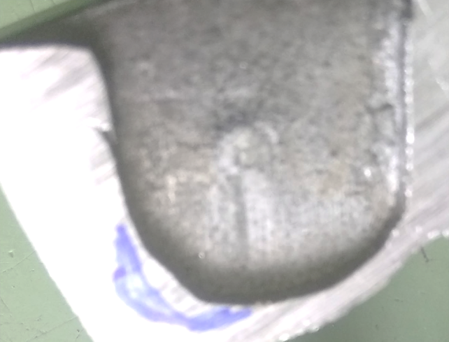
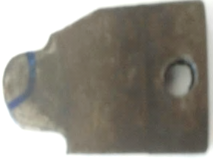
ROOT CAUSE ANALYSIS
Symptoms- Incomplete Equalizer movement
Problem/ Cause- Undersize cavity
Root Cause- Worn out Slider

Slide 8
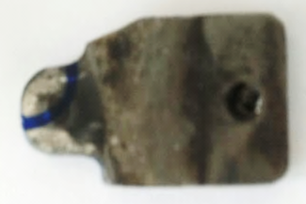
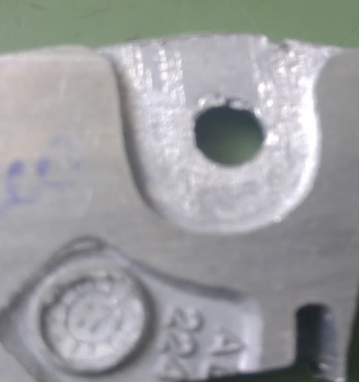
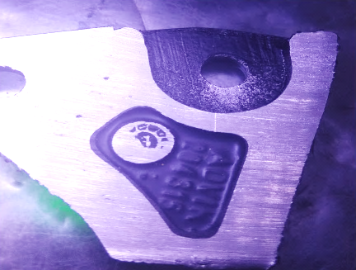
ACTION TAKEN
To increase punch hardness nitriding process added instead of hardening so it will be hardness up to 58 to 60 HRC
After correction give identification punch dot both cavity 224116,224316 inside hole
OK Profile Cavity No 224116
OK Profile Cavity No 224316

Slide 9
A3-Problem Solving Sheet

Slide 10
Root Cause Analysis- Live case
Dimension 1.2 undersize
More depth of Cut at back facing opr.
Width (10 mm) Oversize
Depth variation in casting stage
Incorrect Job clamping
Tool travel more
Incorrect Job clamping
More depth of cut
Cavity pin worn out
Cavity pin undersize
Play in tool holder
Chips on resting face
Weak pulling force
Parts worn out
Life over
Forced deterioration
Life over
Forced deterioration
Incorrect pin size

Slide 11
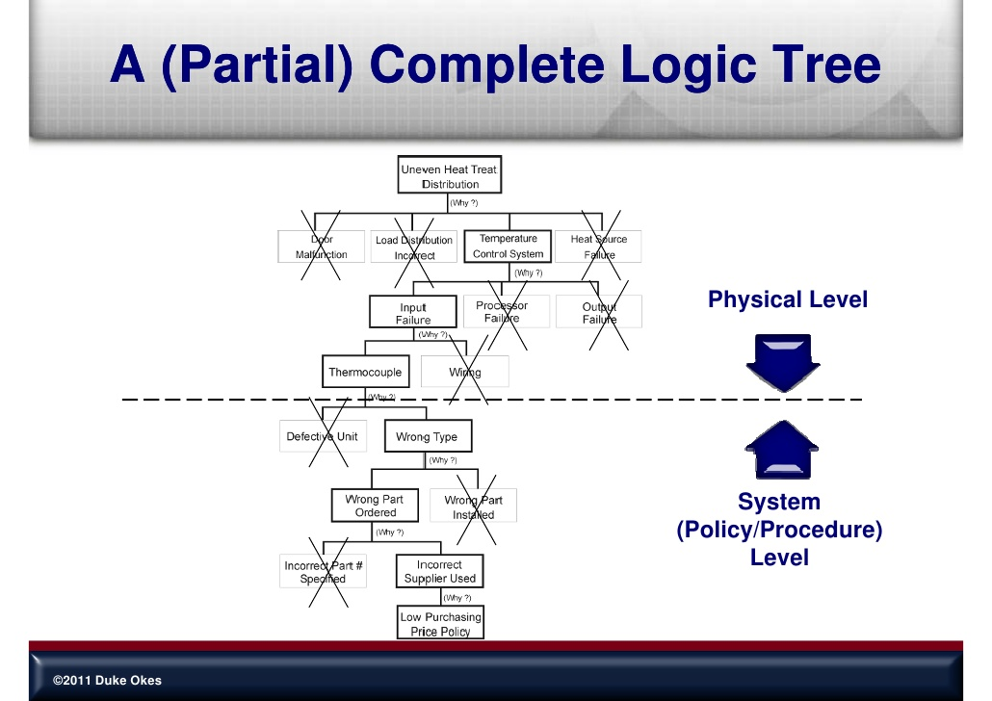
TRC
MRC

Slide 12
Management Root Cause
Slider worn out
To increase punch hardness nitriding process added instead of hardening so it will be hardness up to 58 to 60 HRC
No mechanism
CTQ not define
APQP not effective
OK Profile Cavity No 224116

Slide 13
Presentation Guide

Slide 14
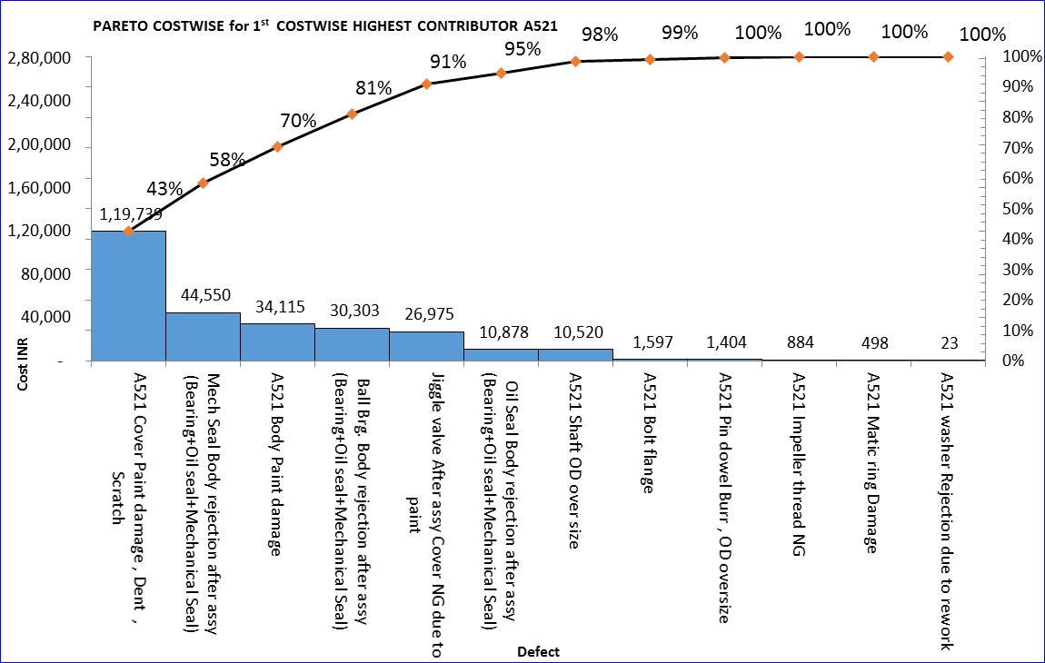
Presentation Guide- Sample
Business Target: Reduction of Internal Rejection from 3% to 2.76%
Defect Trend
Contribution
Sub Part Analysis
Problem Description

Slide 15
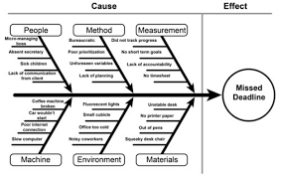
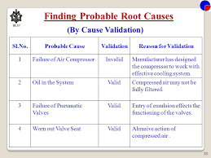
5 Why Analysis
Validated Cause
Why-1
Why-2
Why-3
Why-4
Why-5
Root Cause

Slide 16
Action Plan- Sample

Slide 17
Thank You All

