Slide 1
Early Warning Signals : Employee Attrition

Slide 2
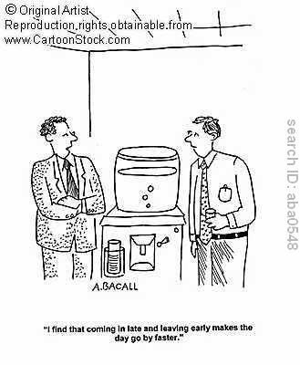
Warning Signals: To be Watched!!
Coming late and leaving early
Absenteeism
Increased mistakes
Low commitment levels
Lack of involvement
Increase in Unplanned leaves

Slide 3
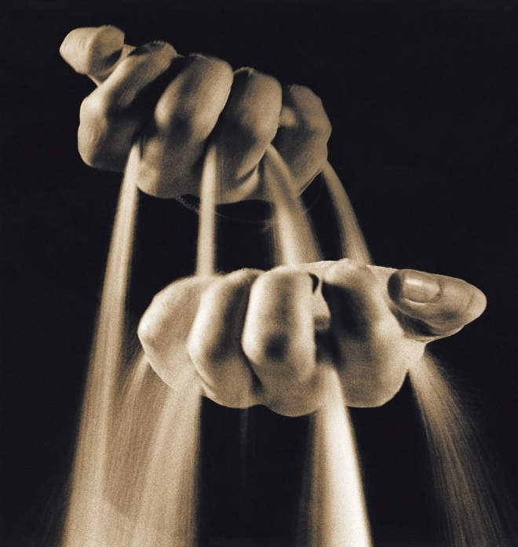
Warning Signals- To watch !!
Employees do not care about problems or happenings in the organization
Tendency towards superficiality
Lack of participation
Sudden interest in long term projects.

Slide 4
How to identify, if employee is preparing to resign ???

Slide 5
1. The Paper Shuffle
Using the office mail for personal business ?
Becoming focused on clerical activities that are not a normal part of the routine??
Increased use of office duplicating equipment for duplicating letters of recommendation? ?
Making copies of a resume to send to prospective employers??

Slide 6
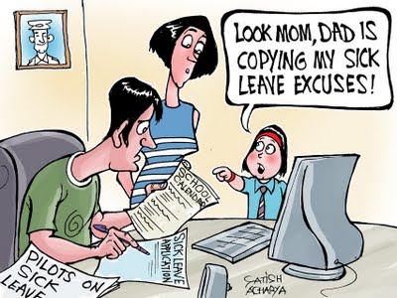
2. Employee Space Cadets
Employees are bored with current job duties ??
Employees spend too little or too much time on specific tasks ??
Employee's length of concentration is not as long as it used to be ??
Healthy employees start taking time off from work designated as "sick leave“ ??

Slide 7
3. Change in Dress
Employee arrives at work in extraordinary formal dress, may be a job interview is only hours away ??
The employee who never carried a briefcase now have one in hand ??
Purchasing a day of vacation in the middle of the week, and not present that "best look" at the office ??

Slide 8
4. The Ringing Telephone
Increase in the number of telephone calls in and out of the work place by and for a particular employee??
A pattern of repeating telephone numbers requesting return calls by the potential job searcher??
Employee's need for privacy on the telephone increases??
Long distance telephone charges begin showing up on the monthly telephone bill ??

Slide 9
5. The Loner
Those who have previously been regularly functioning part of the office who suddenly start going to lunch alone and in other ways separate themselves ???

Slide 10
Recommended Action Plan Retain - Potential employee Separation

Slide 11
3 tier Action plan
To arrest attrition a 3 tier Action plan needs to be followed
Steps need to be taken by :
Line Manager
Plant / Sales Head
HR Lead

Slide 12
Action Plan -> Line Managers:
Have a continuous watch on symptoms indicated in previous slides - day to day basis;
Validate symptoms from colleagues - if necessary;
Establish a high level of CONNECT with the employees;
Begin one-on-one dialogue to understand the Concerns /Anxieties/ disconnect ;

Slide 13
Work out necessary game plan to arrest unnecessary anxieties ;
Provide direct/indirect support in case of emotional imbalances ,including seeking help from colleagues & friends ;

Slide 14
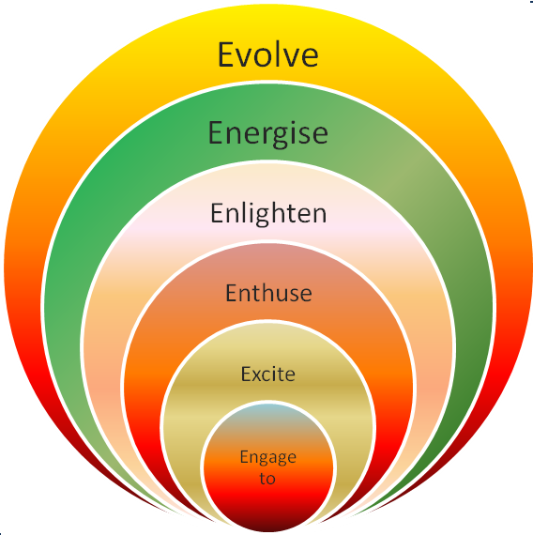
Role -Line Manager

Slide 15
Action Plan - Plant/ Sales Head
Develop a format to track concerns of business’ key talent
Set up one to one dialogue & skip level meets with individuals to arrest undue anxieties
Include employee retention & people engagement ,as regular talking points to drive the message that employees are vital resource for the business to succeed

Slide 16
Provide help to Line manager / Department Heads / HR Leads , in dealing with the anxieties and abnormalities
Reinforce the belief - 24 x 7 :
“Regular Communication & Meaningful Engagement is a lifeline for meaningful relationship and necessary element to Great place to work …..”

Slide 17
Action Plan- HR Lead
Throw up data pertaining to prevailing attrition rate & Reasons , in monthly departmental meetings & MCMs
Focus on Exit-interviews
Share an insight about internal problems, employees’ perceptions of the organization, underlying workplace issues on monthly basis to seek necessary support .

Slide 18
 | Month: |  | Business |  | Unit / Sales / Location Head
WEEKLY EMPLOYEE RETENTION UPDATES
 | Current Head Count as on date | Total No. of Red cases only (B) | % Rate of Potential Attrition (B/A)*100 | Colour Code | Legend
 | A | B | C | Red | Potential Attrition
 |  |  |  | Amber | Fence Sitter / Borderline case
 | 10 | 2 | 20.00% | Green | Safe and Sound
Early Warning Tracker (1st April 2011 - 31st Mar 2012 )
SNo. | Name | Grade | Tenure | Symptoms observed | What Action has been already taken | What further needs to be done | Colour Code | Expectation from superior
1
2
3
4
5
6
* Please insert rows incase you have more than 6 Direct Reports. This has to be be filled for all your Direct reports with Colour Code. To be reported every 10 days.
 | Filled by Name: |  |  |  |  | Unit HR
 | Guidelines
1 | Please fill in the Head count in Cell C10 based on the total employees reporting to you currently
2 | The total number of Red Colour Cases means that there is a highest probability of attrition and you are rasining a signal ~ Potential. Please report in Cell D10
3 | The Cell E10 gives the Potential attrition rate (%) to give you an indication from an early warning point of view.
4 | Please fill in all the employees in the rows 13 to 18 and put the colour code as given in the Legend
5 | Please fill short updates on each line item in the above rows & cells and this is a checklist approach to ensure we have person updates in our team
6 | Please forward this to your Superior and they inturn will be sending it to their respective COO of the Business.
7 | This needs to be reported every 10th of the month / 20th of the Month & 30th of the Month without fail
8 | A copy of this needs to be marked to the Unit HR rep
 | An example is given to calculate the potential attrition %

