Slide 1
Quality Tools
Problem Solving

Slide 2
Quality Control Tools
    Pareto chart
    Histogram
    Process flow diagram
    Check sheet
    Scatter diagram
    Control chart
      Run chart
    Cause and effect diagram

Slide 3
Pareto Principle
Vilfredo Pareto (1848-1923) Italian economist
  20% of the population has 80% of the wealth
Juran used the term “vital few, trivial many”. He noted that 20% of the quality problems caused 80% of the dollar loss.
7 Quality Tools

Slide 4
Pareto chart
% Complaints
7 Quality Tools

Slide 5
Pareto
Chart
70
(64)
60
50
40
Percent from each cause
30
20
(13)
(10)
10
(6)
(3)
(2)
(2)
0
Poor Design
Defective parts
Operator errors
Machine calibrations
Defective materials
Wrong dimensions
Surface abrasions
Causes of poor quality
Notes:
Pareto analysis uses an ordered histogram to highlight the major causes of quality problems.

Slide 6
Histogram
7 Quality Tools

Slide 7
Histogram
40
35
30
25
20
15
10
5
0
1 2 6 13 10 16 19 17 12 16 20 17 13 5 6 2 1
Notes:
Histograms are graphical frequency tables that visually capture and display the variation in a set of data.

Slide 8
Flowcharts
Flowcharts
  Graphical description of how work is done.
  Used to describe processes that are to be improved.
7 Quality Tools

Slide 9
Flow Diagrams
" Draw a flowchart for whatever you do. Until you do, you do not know what you are doing, you just have a job.”
    -- Dr. W. Edwards Deming.

Slide 10
Flowchart
Activity
Decision
Yes
No
7 Quality Tools

Slide 11
Flowchart
Notes:
A flowchart diagrams the steps in a process. Flowcharts help problem solvers better understand the process so they can highlight quality problems.

Slide 12
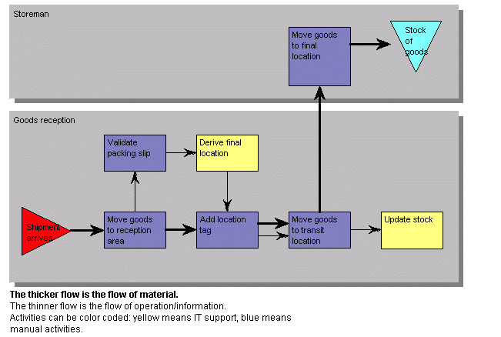
Flow Diagrams

Slide 13
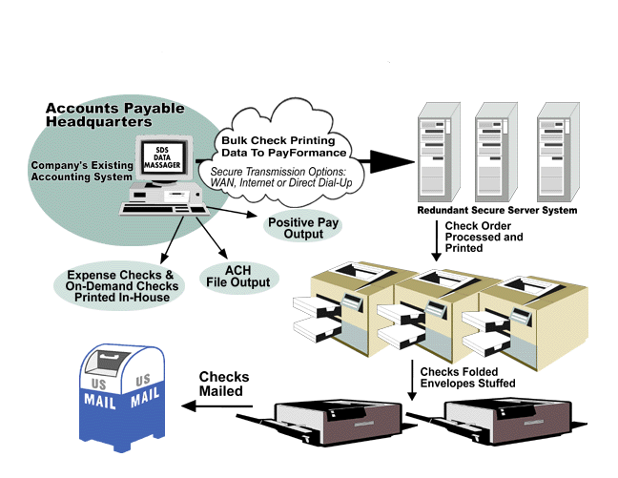
Flow Diagrams

Slide 14
Process Chart Symbols
Operations
Inspection
Transportation
Delay
Storage

Slide 15
Process Chart
Date: 9-30-00
Location: Graves Mountain
Analyst: TLR
Process: Apple Sauce
Step
Operation
Transport
Inspect
Delay
Storage
Description
of
process
Time
(min)
Distance
(feet)
1
Unload apples from truck
20
2
Move to inspection station
100 ft
3
Weigh, inspect, sort
30
4
Move to storage
50 ft
5
Wait until needed
360
6
Move to peeler
20 ft
7
Apples peeled and cored
15
8
Soak in water until needed
20
9
Place in conveyor
5
10
Move to mixing area
20 ft
11
Weigh, inspect, sort
30
Page 1 0f 3
Total
480
190 ft

Slide 16
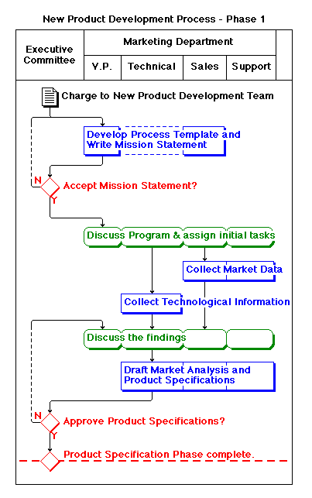
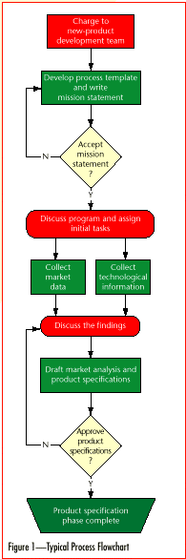

Slide 17
Check Sheet
Shifts
√ √ √
√ √ √ √
√
√ √ √
√ √
√ √ √
Defect Type
√ √ √ √
√ √ √
√ √
√
7 Quality Tools

Slide 18
Check Sheet
COMPONENTS REPLACED BY LAB
TIME PERIOD: 22 Feb to 27 Feb 1998
REPAIR TECHNICIAN: Bob
TV SET MODEL 1013
Integrated Circuits ||||
Capacitors |||| |||| |||| |||| |||| ||
Resistors ||
Transformers ||||
Commands
CRT |
Notes:
A check sheet is a fact-finding tool used to collect data about quality problems. A typical check sheet tallies the number of defects by previously identified categories. The next step is to graph the defects per category in a histogram.

Slide 19
Cause-and-Effect Diagrams
Show the relationships between a problem and its possible causes.
Developed by Kaoru Ishikawa (1953)
Also known as …
  Fishbone diagrams
  Ishikawa diagrams
7 Quality Tools

Slide 20
Cause and Effect “Skeleton”
Materials
Procedures
Quality
Problem
People
Equipment
7 Quality Tools

Slide 21
Fishbone Diagram
Measurement
Human
Machines
Faulty testing equipment
Poor supervision
Out of adjustment
Incorrect specifications
Lack of concentration
Tooling problems
Improper methods
Inadequate training
Old / worn
Quality
Problem
Inaccurate
temperature
control
Defective from vendor
Poor process design
Ineffective quality
management
Not to specifications
Dust and Dirt
Material-
handling problems
Deficiencies
in product design
Environment
Materials
Process
Notes:
A cause-and-effect diagram, or fishbone diagram, is a chart showing the different categories of problem causes.

Slide 22
Cause and effect diagrams
Advantages
  making the diagram is educational in itself
  diagram demonstrates knowledge of problem solving team
  diagram results in active searches for causes
  diagram is a guide for data collection

Slide 23
Cause and effect diagrams
To construct the skeleton, remember:
For manufacturing - the 4 M’s
  man, method, machine, material
For service applications
  equipment, policies, procedures, people

Slide 24
Scatter Diagram
.
Notes:
Scatter diagrams and tightness of points plotted on the graph gives an indication of the strength of the relationship. A cluster of points resembling a straight line indicates the strongest correlation between the variables. In this graph, there is a strong positive correlation between x and y.

Slide 25
Run Charts
Run Charts (time series plot)
  Examine the behavior of a variable over time.
  Basis for Control Charts

Slide 26
Control Chart
27
24
UCL = 23.35
21
18
c = 12.67
15
Number of defects
12
9
6
3
LCL = 1.99
2
4
6
8
10
12
14
16
Sample number
Notes:
Process control involves monitoring a production process and charting the results on a control chart. If any of the points plotted falls outside the control limits, the process is out-of-control.

Slide 27
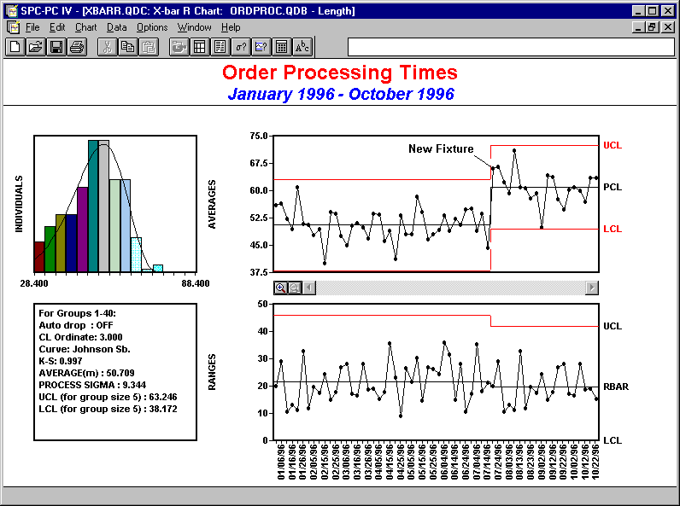
Control Charts
7 Quality Tools

Slide 28
“Stem and leaf” displays
Data
Integrated Circuit Response Time (ps)

Slide 29
“Stem and leaf” displays
Integrated Circuit Response Time (ps)
3 7 4 4 7 7 4 3 7 9
4 6 0 1 5 6 2 6 7 1 1 5 6 4 8 3 4
5 6 1
6 0 0

Slide 30
Dot diagrams
Integrated Circuit Response Time (ps)
3
4
5
6
Plant A
Plant B

